Slide 1
Office 365 - Project Governance Framework

Slide 2
Program Governance - Goals
Define and implement a structure within which to execute program management and administration
Provide active direction, periodically review interim results, and identify and execute adjustments to ensure achievement of the planned outcome (which contributes to success of the overall business strategy)

Slide 3
Program Governance - Elements
Organizational structures. These may include a program steering committee, a Program Management Office (PMO), the program organizational model, and the project organizational model.
Roles. These may include the executive sponsor(s), a steering committee member, the program director / manager, the PMO manager, technical project managers and technical SME’s
Mechanisms. Designed to provide guidance and direction, these may include policies, governance principles, and decision or authority specifications.

Slide 4
Program Governance – Structure
Strategic Governance
Executive/Project Sponsor
Program
Steering Committee
Management Governance
Program Manager
Operational Governance
Lead Architect
Technical Project Manager
PMO
Risk / Change Manager
Communication Manager
Technical Leads & Execution Team

Slide 5
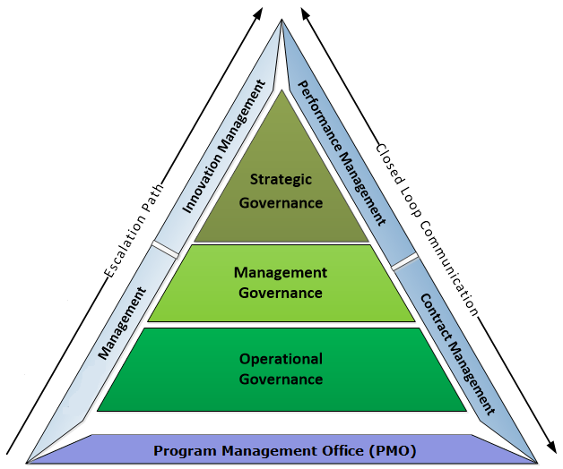
Program Governance - Model
Strategic Governance: Provides strategies to sustain and improve delivery performance, drive business objectives and strengthen relationship for mutual benefits
Management Governance: On the direction of the Executive Committee, structured reviews are conducted monthly to inspect the Delivery Performance, Demand Management, Transition and Transformation status at the Account Management level. Overall compliance and project status reports are reviewed for performance exceptions. Upon identification of a performance or an escalated issue, a detailed description of the service or project is conducted.
Operational Governance: Operational governance provides detailed weekly tracking of day-to-day delivery performance. It also provides inputs to Account Management on delivery performance and helps escalate matters as per the agreed escalation matrix
PMO: The overall governance will be managed by the PMO for scheduling the meetings, tracking action items, publishing the required reports and dashboards
T&T

Slide 6




Program Governance – Roles
Project Champion
Approves the project Charter
Business Case Owner
Accountable throughout the life span of the program
Prioritization of the project within the organization
Determines how the project goals and objectives are measured
Approve the project management plan, implementation plan and metrics
Monitors & controls the project to ensure alignment with charter
Escalation point for any project deviations
Created consistency among project and program governance
Lessons learned, best Practices
Provides traceability for PPM governance
Manages interdependencies
Execute in accordance to the establish governance plan
Track the ROI on establishing the PPM governance
Manages the progress and performance of the governance plan
Executes the communication plan
Manages the stakeholders based on their establish expectations
Project Sponsor:
Strategic Direction
A Project oversight function, that glues together all stakeholders
Steering Committee:
Operational Director
PMO
Operational Director
Project Manager
Tactical Direction
Executes in accordance to the objective set by the project sponsor, Steering committee and PMO
A Supervisory board within the governance Structure that is accountable for managing and addressing business issues, monitors risks, quality and project timeline

Slide 7
Program Governance – Roles
Owning the overall architecture
Participating in all required meetings both internally and with customer front facing
Providing reasonably requested data information pertaining to the overall architecture
Providing inputs into technical solution, design and projects on an ad-hoc basis
Putting in place policies and guidelines
Being the link between the technical lead across all technology
Develop and maintain a technology project plan, which outlines a project's tasks, milestone dates, status, and allocation of resources
Assist tem to prioritize the set of technical issues
Proactively manage changes in project scope, identify potential crises and devise contingency plans
Develop and deliver progress reports, requirements documentation and presentations
Responsible for the architecture of the technical solution
Create and review the HLD/LLD, SOP’s, runbook’s, publishing test results, training documents, handover plan
Execute / implement the design plan
Updating the detailed design documentation on a regular basis
Review and schedule change requests in accordance with Change Management procedure and requirements
Identify operations risks and mitigation plans
Identifying improvement initiatives to improve performance against targets
Provide required training to the operations team
Smooth Handover to the delivery operations team
Lead Architect
Technical Project Manager
Technical Lead

Slide 8
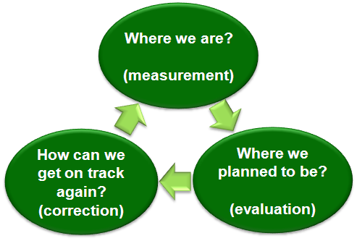
Program Monitoring & Control
Review of Event Log – Identified risks, Issues, Changes, Decisions and Action Items
Review on Project Performance – Resource utilization, Key Milestones & Deliverables
Communication – Weekly Status report to Stakeholders, Recommendations for intervention and corrective actions from senior management
Lessons Learnt – Document lessons learnt from closed initiatives
Change Control - Managing change control request & Effectively manage deviations from baseline

Slide 9
Critical Milestones & Approvals

Slide 10
Program Governance - Meetings
Executive Sponsor
Operational / Project Director
Program Manager
Lead Architect / Technical
PMO
BI - WEEKLY
Transition Plan, progress, and achievement of Critical Deliverables and key activities
Monitor compliance to contract terms and conditions and provide recommendations to resolve issues pertaining to non-compliance
Decisions and approvals to be taken on any change in scope
Operational / Project Director
Program Manager
Lead Architect / Technical
PMO
WEEKLY
Addressing operational issues or crises arising during the previous week, and adherence to performance targets;
Reviewing Root Cause Analysis of any previous issues;
Addressing outstanding or unresolved issues;
Reviewing progress reports;
Planning for future changes;

Slide 11
Dashboard - Template
A. EXECUTIVE SUMMARY – a summary of the progress for this period (not of the initiative)
A B C
E. MILESTONES
Key Activity | Planned Date | Projected Date | Last Period | This Period
B. KEY ACCOMPLISHMENTS THIS PERIOD
A B C
C. ACTIVITIES BEHIND SCHEDULE
A B C
D. KEY ACTIVITIES PLANNED NEXT PERIOD
A B C
F. KEY RISKS – typically future challenges or external circumstances that may affect the initiative
Risks to be addressed | Mitigating Action
G. MATTERS FOR IMMEDIATE ATTENTION – typically specific current issues or scope changes
Issues to be resolved | Recommended Action
H. GENERAL COMMENTS – must include reasoning for an overall Red or Amber Status

